Slide 1
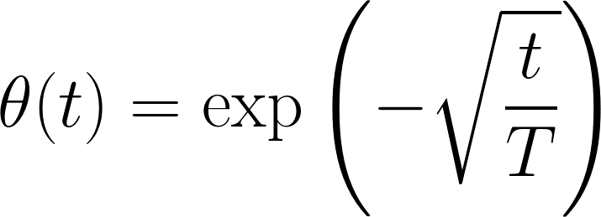
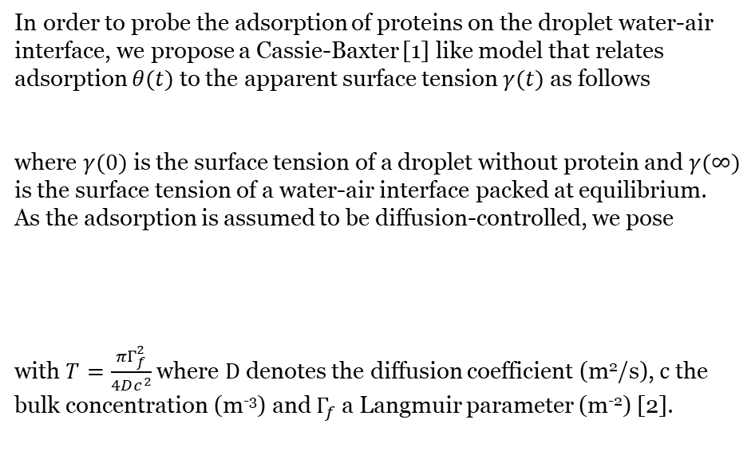
In order to probe the adsorption of proteins on the droplet water-air interface, we propose a Cassie-Baxter [1] like model that relates adsorption $θ(t)$ to the apparent surface tension $γ(t)$ as follows
where $γ(0)$ is the surface tension of a droplet without protein and $γ(∞)$ is the surface tension of a water-air interface packed at equilibrium.
As the adsorption is assumed to be diffusion-controlled, we pose
with $T=\frac{πΓ_{f}^{2}}{4Dc^{2}}$ where $D$ denotes the diffusion coefficient (m²/s), $c$ the bulk concentration (m⁻³) and $Γ_{f}$ a Langmuir parameter (m⁻²) [2].
[1] Cassie ABD, Baxter S (1944) Wettability of porous surfaces. Trans Faraday Soc 40:546–550
[2] Rahn, J. R.; Hallock, R. B. Langmuir 1995, 11, 650.

Slide 2
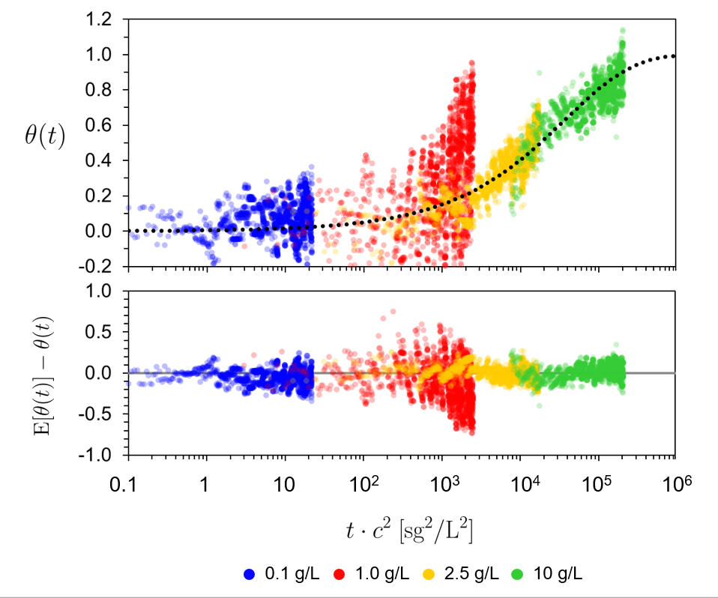

Slide 3
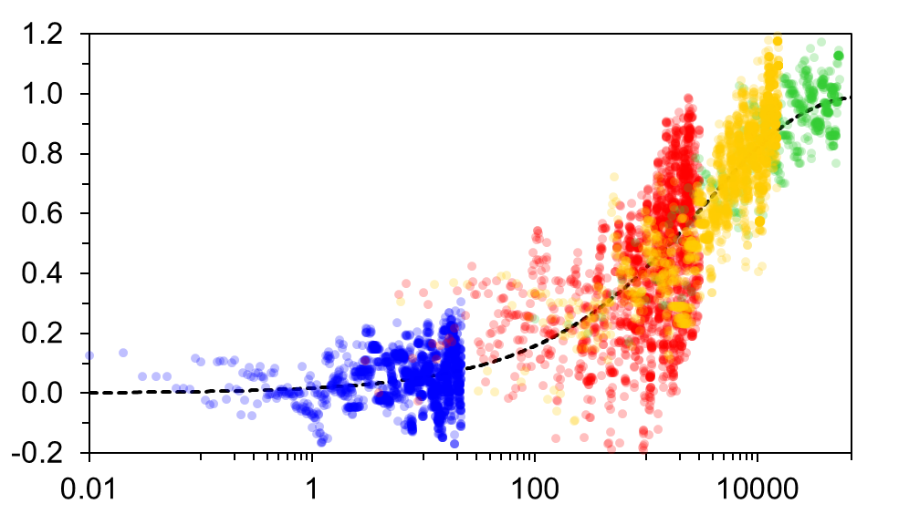
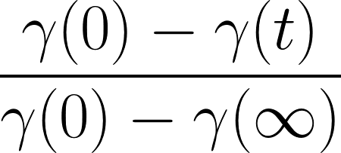

Oude fitting
0.1 g/L
1.0 g/L
2.5 g/L
10 g/L

Slide 4
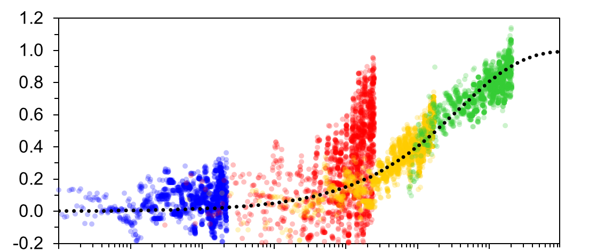
Nieuwe fitting
0.1
1
10
10²
10³
10⁴
10⁵
10⁶
0.1 g/L
1.0 g/L
2.5 g/L
10 g/L

Slide 5

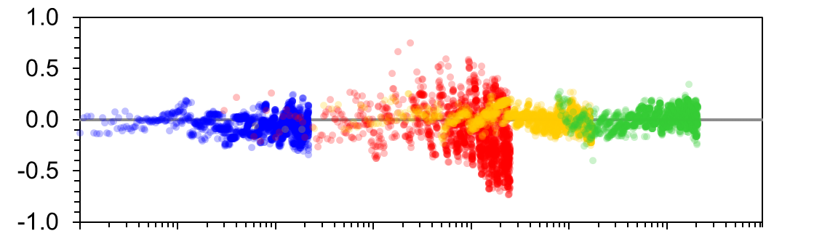

10⁻¹
10⁰
10
10²
10³
10⁴
10⁵
10⁶
0.1 g/L
1.0 g/L
2.5 g/L
10 g/L

Slide 6
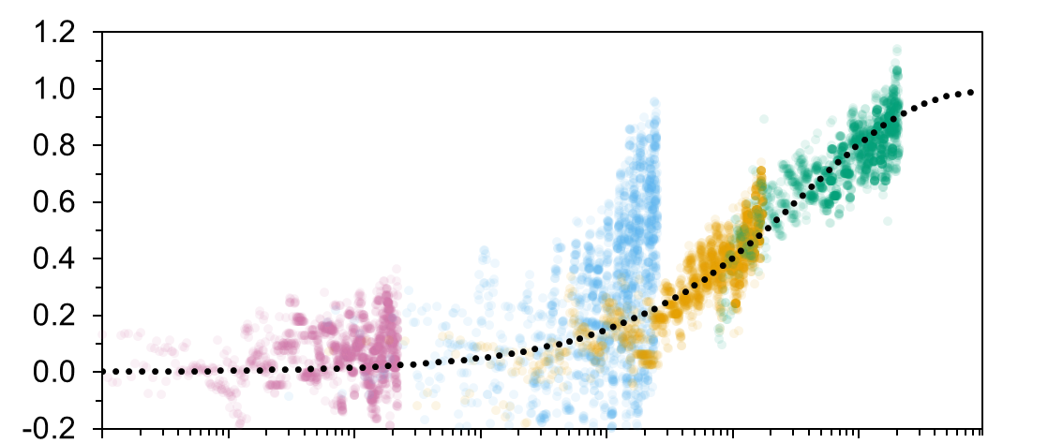
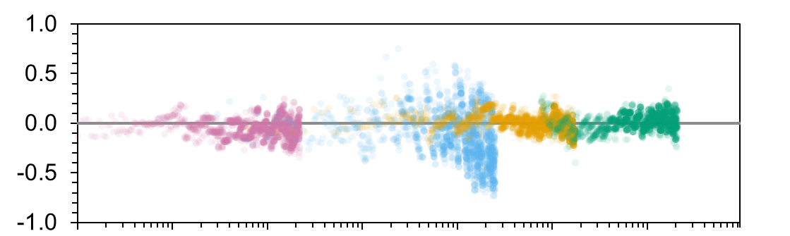
0.1 g/L
1.0 g/L
2.5 g/L
10 g/L
10⁻¹
10⁰
10
10²
10³
10⁴
10⁵
10⁶

Slide 7
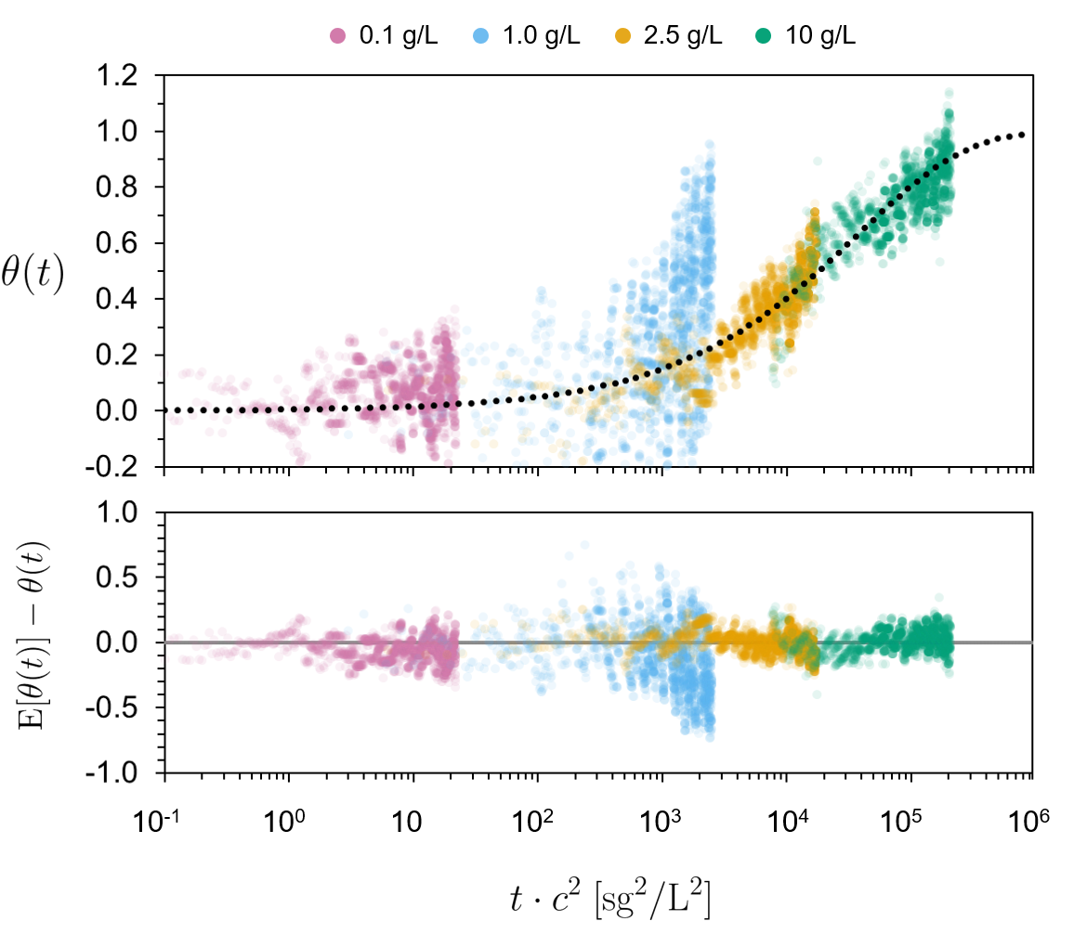

Slide 8
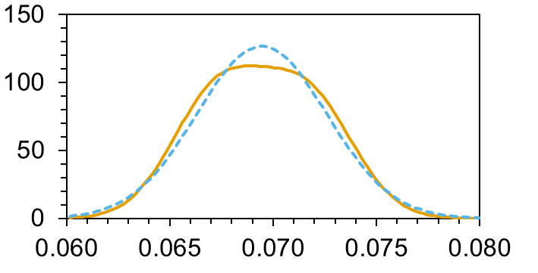

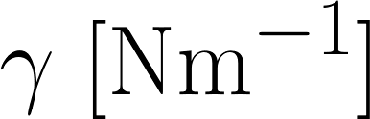
0.06945134 +- 0.006172888

